Slide 1
Understandig Objects
Siraj Eddin Bensasi
172141

Slide 2
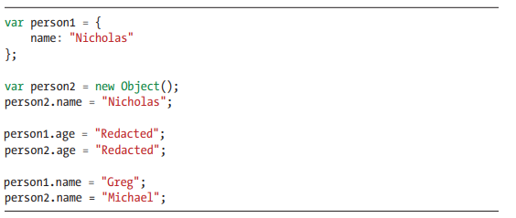
Defining Properties
Properties are the values associated with a JavaScript object.
A JavaScript object is a collection of unordered properties.
Properties can usually be changed, added, and deleted, but some are read only.

Slide 3
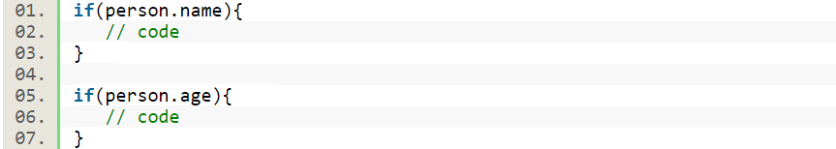
Detecting Properties
In JavaScript we can add a property to an object at any point in code. It is encouraged to check whether a property exists or not before doing some operation using that particular property. To check if a property exists or not there are several methods provided in JavaScript which we will check one by one.
The first method which is often used by most of the JavaScript
developers is checking for “object.propery” inside an if condition.

Slide 4
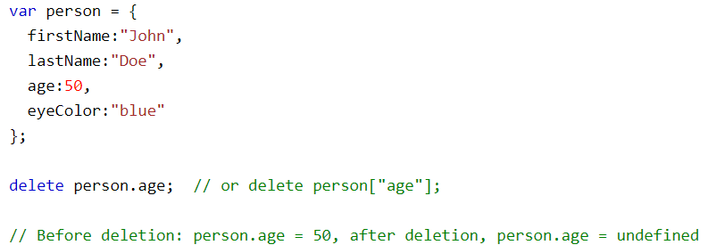
Removing Properties
The delete operator deletes both the value of the property and the property itself.
After deletion, the property cannot be used before it is added back again.
The delete operator is designed to be used on object properties. It has no effect on variables or functions.
Note: The delete operator should not be used on predefined JavaScript object properties. It can crash your application.

Slide 5
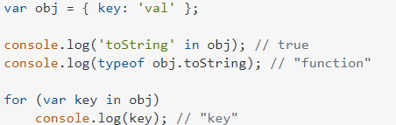
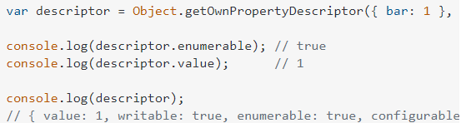
Enumeration
An enumerable property is one that can be included in and visited during for. In loops (or a similar iteration of properties, like Object. Keys()).
If a property isn't identified as enumerable, the loop will ignore that it's within the object
A property is identified as enumerable or not by its own [[Enumerable]] attribute. You can view this as part of the property's descriptor:

Slide 6
Types of Properties
There are two types of object properties: data properties and accessor properties.
1- Data Properties
A data property contains a single location for a data value. A data property has four attributes:
[[Configurable]] – determines whether a property can be redefined or removed via delete operator.
[[Enumerable]] – indicates that if a property will be returned in the for...in loop.
[[Writable]] – specifies that the value of a property can be changed.
[[Value]] – contains the actual value of a property

Slide 7
Types of Properties
By default, the [[Configurable]] , [[Enumerable]], and [[Writable]] attributes set to true for all properties defined directly on an object. The default value of the [[Value]] attribute is undefined.
2- Accessor Properties
Similar to data properties, accessor properties also have [[Configurable]] and [[Enumerable]] attributes.
But the accessor properties have the [[Get]] and [[Set]] attributes instead of [[Value]] and [[Writable]].
When you read data from an accessor property, the [[Get]] function is called automatically to return a value. The default return value of the [[Get]] function is undefined.

Slide 8
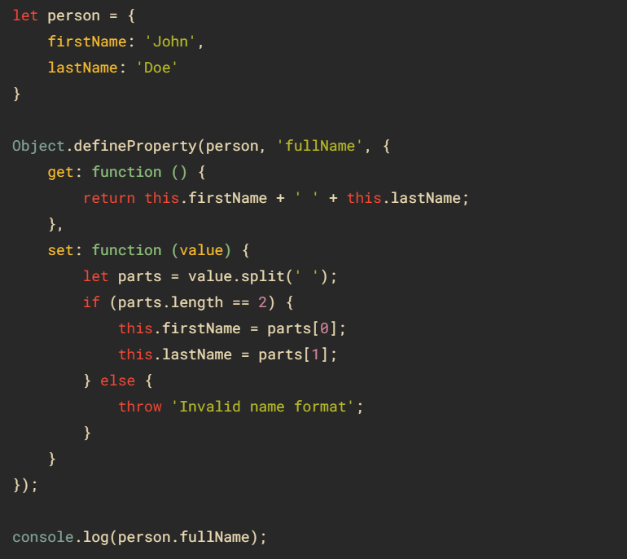
Types of Properties
If you assign a value to an accessor property, the [[Set]] function is called automatically.
To define an accessor property, you must use the Object.defineProperty() method. For example:

Slide 9
Types of Properties
The attributes collection is iterable and has all the attributes of the element (standard and non-standard) as objects with name and value properties. Property-attribute synchronization. When a standard attribute changes, the corresponding property is auto-updated, and (with some exceptions) vice versa.
Common Attributes
There are two property attributes shared between data and accessor properties. One is [[Enumerable]], which determines whether you can iterate over the property. The other is [[Configurable]], which determines whether the property can be changed. You can remove a configurable property using delete and can change its attributes at any time. (This also means configurable properties can be changed from data to accessor properties and vice versa.) By default, all properties you declare on an object are both enumerable and configurable.

Slide 10
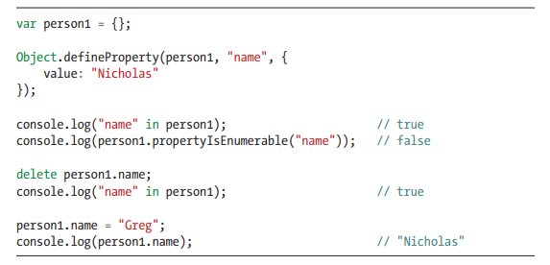
Types of Properties
Data Property Attributes
In short, a data attribute is a single-value descriptor for a data point or data object. It exists most often as a column in a data table, but can also refer to special formatting or functionality for objects in programming languages such as Python.

Slide 11
Preventing Object Modification

Slide 12
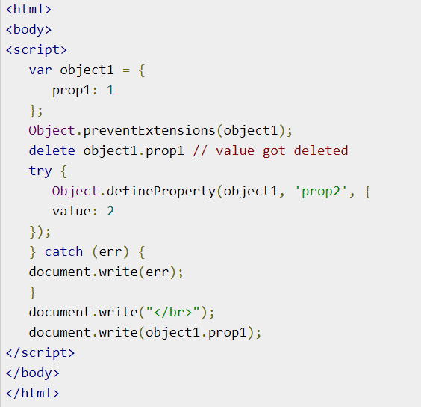
Preventing Object Modification
1- Prevent Extensions
In this level, one cannot add any new properties or methods but can access existing properties or methods. Here there is an ability to delete the respective object. Object.preventExtensions() is the method used to accomplish this task. It prevents any new properties from ever being added to the object

Slide 13
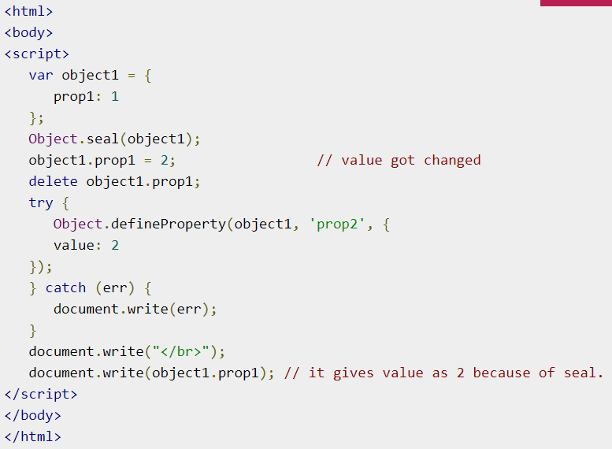
Preventing Object Modification
2- Seal
It is same as preventing extensions, in addition it doesn't allow to delete existing properties or methods. To accomplish this task Object. Seal() method is used

Slide 14
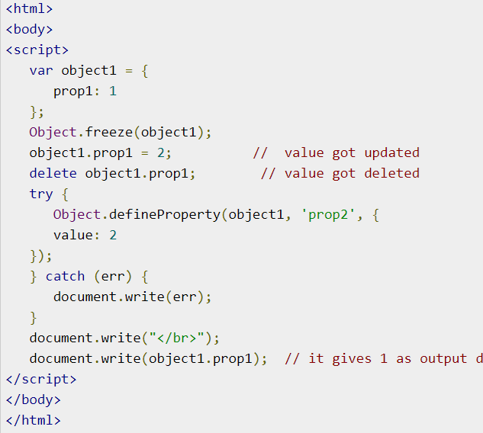

Preventing Object Modification
3- Freeze
In addition to seal's functionality, freeze doesn't allow even to access the existing properties. To freeze an object we use Object.freeze() method. It can also make an object immutable

Slide 15
Summary

Slide 16
Summary
It helps to think of JavaScript objects as hash maps where properties are just key/value pairs. You access object properties using either dot notation or bracket notation with a string identifier. You can add a property at any time by assigning a value to it, and you can remove a property at any time with the delete operator. You can always check whether a property exists by using the in operator on a property name and object. If the property in question is an own property, you could also use hasOwnProperty(), which exists on every object. All object properties are enumerable by default, which means that they will appear in a for-in loop or be retrieved by Object.keys().

Slide 17

Thanks
Do you have any question?
sasiserag@gmail.com

